Slide 1
INVESTOR CONFERENCE
October 8 & 9, 2026
CFG Bank One-On-One
Equity Conference Morocco
Marrakech

Slide 2
AGENDA
01
T2S Group at a glance
02
First-half 2026 highlights
03
Financial performance
04
Financial position
05
Outlook
06
Questions & answers

Slide 3
T2S GROUP AT A GLANCE
01

Slide 4
T2S GROUP AT A GLANCE
WHO WE ARE
A Moroccan leader in integrated medical technology, founded in Casablanca in 1992
A MedTech pioneer in Morocco
Robotic surgery
Morocco's first robotic surgery program and first robotic telesurgery procedures
The Group designs, distributes, installs and maintains high-technology solutions for healthcare professionals, building on long-standing partnerships with leading international manufacturers. From its base in Morocco, it is expanding into sub-Saharan Africa.
Radiotracers
Local cyclotron production in Casablanca for cancer diagnostics
Robotic radiosurgery
Two CyberKnife systems installed in 2026
Our ambition: to give healthcare institutions access to the latest-generation equipment and technologies, and to ensure the best possible care for patients.
Mr. Abderraouf Sordo, Chairman & Chief Executive Officer
Digital solutions
A leading player in medical image archiving (PACS)

Slide 5
T2S GROUP AT A GLANCE
OVER THIRTY YEARS OF GROWTH
2026
Cyclopharma now 100% owned
Casablanca Stock Exchange listing
IVD business launched
2025
Integrated, digitalized logistics platform
2011
2009
First turnkey project in Africa
2021
T2S Group Holding established
2023
GE HealthCare agreement covering more than 20 African countries
2008
Binarios founded (digital solutions)
2021
Helios Investment Partners becomes a shareholder
03
Accelerating
2023 – 2026
2007
Cyclopharma founded (radiopharmacy)
2016
CDG Invest Growth becomes a shareholder
1998
IM Alliance founded (medical devices)
02
Structuring the Group
2016 – 2021
1992
T2S SA founded in partnership with GE HealthCare
01
Building the integrated model
1992 – 2011

Slide 6

T2S GROUP AT A GLANCE
THE FOUNDATIONS OF OUR SUCCESS
01
02
03
A Tier 1 brand portfolio spanning many medical specialties, with a strong technology focus
Strong, long-standing partnerships with leading international suppliers
Highly qualified, certified biomedical technicians and engineers
04
05
06
A regional presence, notably through local partnerships
Expert, experienced management and best-in-class governance
A centralized, digitalized logistics and storage infrastructure

Slide 7



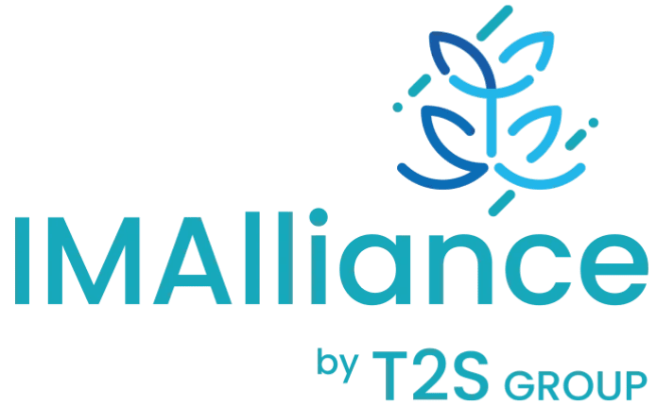
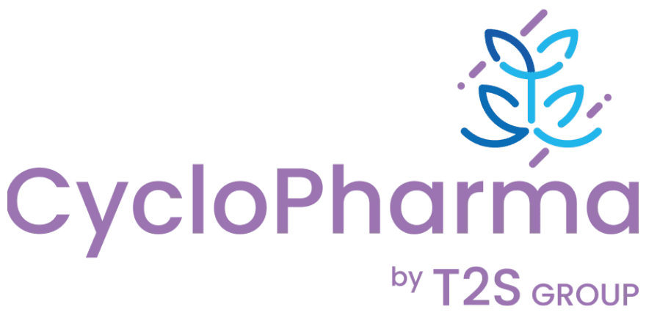
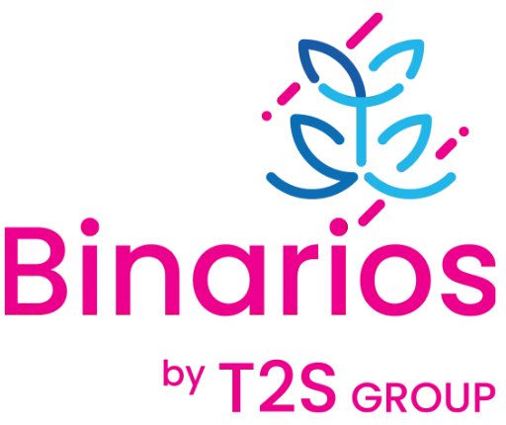



T2S GROUP AT A GLANCE
FIVE BUSINESS LINES, THREE MARKETS
An integrated operator, benefiting from synergies across its businesses and the trust of its customers
Five business lines, four subsidiaries
High-Tech Equipment
Medical Devices & IVD
Services
Diagnostic Pharma
Digital Systems
CT, MRI, mammography
Nuclear medicine, radiotherapy
Ultrasound, operating rooms
Cardiology, endoscopy
Minimally invasive and robotic surgery
Laboratory analyzers and reagents
Installation and commissioning
Maintenance and upgrades
User training
Contrast media
Cyclotron-produced radiotracers
Nuclear medicine
Medical image archiving (PACS)
Hospital information systems
Laboratory and pharmacy solutions
Three markets
served by the Group
Public sector
Hospital modernization and equipment programs
International
French-speaking sub-Saharan Africa, more than 20 countries
Private sector
hospitals, imaging centers and laboratories

Slide 8
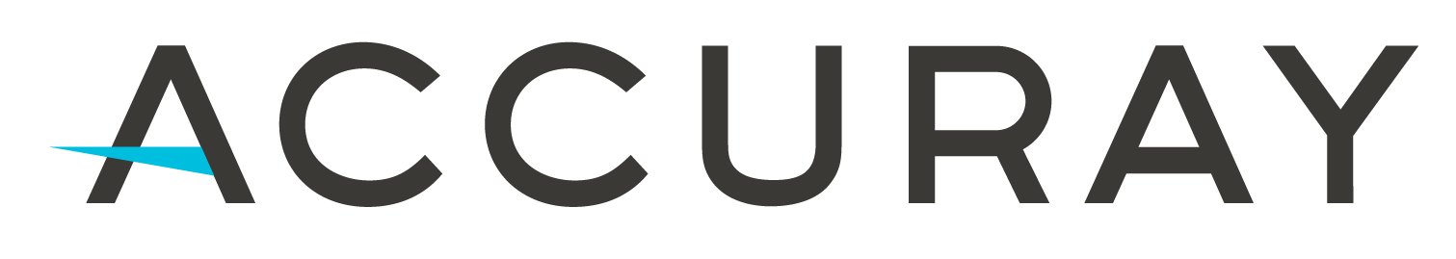
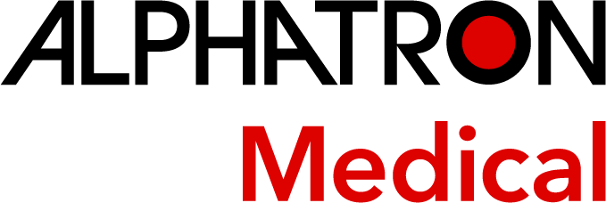







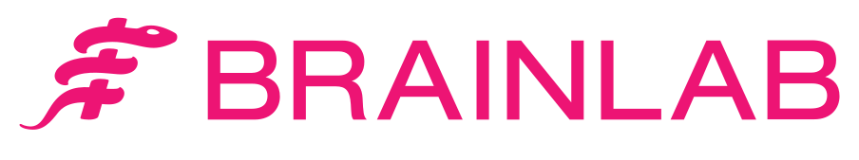




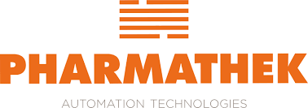


T2S GROUP AT A GLANCE
OUR PARTNERS
Long-term partnerships with global leaders in medical technology
LONGSTANDING PARTNER
Since 1992
Partner of the Group since its inception
20+ countries
in French-speaking sub-Saharan Africa covered by the distribution agreement

Slide 9
KEY FIGURES
THE GROUP IN NUMBERS
451
Employees
20+
Countries of operation in Africa
1,500+
Customers served since inception
8,000+
Product references
1,763 ^{MDH}
2025 revenue
388 ^{MDH}
2025 EBITDA
205 ^{MDH}
2025 net income, Group share
1,442 ^{MDH}
2025 shareholders' equity

Slide 10
FIRST-HALF 2026 HIGHLIGHTS
02

Slide 11
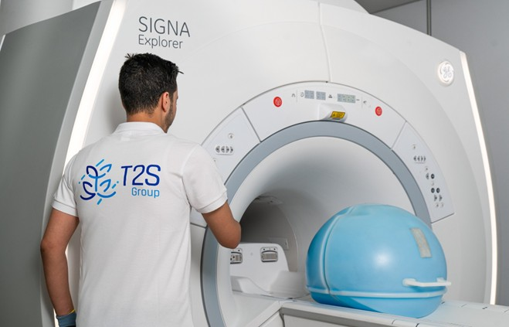

HIGHLIGHTS
FIRST HALF 2026
AMMC approval obtained and T2S Group IPO completed in July 2026.
Contract awarded to install Morocco's first GE HealthCare PET-MR, at Ibnou Sina Hospital in Rabat.
Buyout of Cyclopharma's minority shareholders: T2S Group now owns 100% of its share capital.
Creation of a wholly owned subsidiary in the United Arab Emirates, dedicated to the Group's expansion in Africa.
Launch of an incentive plan for a category of employees through the grant of ordinary shares.

Slide 12
INITIAL PUBLIC OFFERING
OFFERING SUMMARY AND SHAREHOLDING
1,100 MDH
Total offering size
223 DH
Price per share
4,860 MDH
Valuation at IPO
July 27
First day of trading, 2026
Indicative post-IPO shareholding
Offering structure
22.6%
free float
350 MDH
Capital increase
1,569,506 new shares
750 MDH
Sale by Trone Investment Holdings
3,363,228 existing shares
143 MDH
Capital increase reserved for the founder
at 178.40 DH per share
Helios funds (via Trone)
Use of the 350 MDH raised
Management and founders
Fund the investments needed to grow the businesses, particularly in vitro diagnostics
Strengthen financial capacity to seize external growth opportunities
Accelerate expansion in Africa by gradually rolling out the Moroccan model
Free float
Other shareholders

Slide 13
FINANCIAL PERFORMANCE
03

Slide 14
RESULTS REVIEW
REVENUE
2023–2025 track record (MDH)
CAGR +13.3%
H1 2026 vs. H1 2025 (MDH)
+26%
Between 2023 and 2025, consolidated revenue grew at an average annual rate of 13.3%, reaching 1,763 MDH in 2025. Growth was broad-based across all businesses: High-Tech Equipment, with the launch of new oncology product lines; Medical Devices & IVD, driven by the expansion of robotics and the nationwide roll-out of mandatory health insurance (AMO); Digital Systems, on the back of fast-growing digital pharmacy; and Diagnostic Pharma, with the ramp-up of cyclotron production.
In H1 2026, revenue grew 26%, led by High-Tech Equipment (+40%) and Medical Devices & IVD (+9%).

Slide 15
RESULTS REVIEW
REVENUE BY BUSINESS LINE
H1 2026 vs. H1 2025 (MDH)
H1 2026 breakdown (%)
+40%
+9%
+10%
+8%
+148%
978
MDH
High-Tech Equipment
Medical Devices & IVD
Services
Diagnostic Pharma
Digital Systems
High-Tech Equipment (+40%) accounted for nearly two-thirds of growth, driven by public equipment programs and projects in French-speaking Africa.
Digital Systems more than doubled (+148%); businesses with a recurring profile (Medical Devices & IVD, Services, Diagnostic Pharma) grew 9%.
(1) Radiology, oncology, operating room and hospital care solutions. (2) IVD: in vitro diagnostic equipment and reagents for laboratories.

Slide 16
RESULTS REVIEW
REVENUE BY GEOGRAPHY
H1 2026 breakdown (%)
Morocco
857 MDH
+15%
Growth driven notably by public-sector sales, under healthcare facility modernization and equipment programs.
H1 2026
978 MDH
International
121 MDH
+295%
Delivery of healthcare facility equipment projects in French-speaking Africa, building on the expansion already under way in these markets.
A solid Moroccan base, complemented by a growing international footprint, supported since 2026 by a dedicated Africa subsidiary set up in the United Arab Emirates.
The Group benefits from the complementary nature of its presence in public, private and international markets.

Slide 17
SERVICES
INSTALLED BASE UNDER MAINTENANCE
244
+20%
Maintenance: a reflection of customer trust
healthcare facilities under maintenance contract
Support throughout the equipment lifecycle
Installation, user training, maintenance and equipment upgrades.
Local presence
More than 100 certified biomedical technicians and engineers, based across the regions.
2,473
+24%
Certified quality
Group ISO 9001 and ISO 13485 certifications renewed.
Satisfied customers
96% customer satisfaction in 2026, up 3 points on 2025.
units of equipment under maintenance contract
The growing installed base strengthens long-term relationships with healthcare facilities, at the heart of the Group's integrated model.
Services revenue reached 114 MDH in H1 2026, up 10%.

Slide 18
RESULTS REVIEW
EBITDA
2023–2025 track record (MDH)
CAGR +25.7%
H1 2026 vs. H1 2025 (MDH)
+42%
Between 2023 and 2025, EBITDA grew at an average annual rate of 25.7%, twice as fast as revenue. The EBITDA margin rose from 17.9% to 22.0%, driven by a strong increase in gross margin and tight control of operating expenses despite the expansion of the teams.
In H1 2026, EBITDA rose 42%, outpacing revenue: the EBITDA margin reached 24.8%, compared with 22.0% in H1 2025, driven by volume effects and tight control of staff costs.

Slide 19
RESULTS REVIEW
EBITDA BRIDGE – H1 2026
EBITDA bridge (MDH)
+42% vs. H1 2025
EBITDA margin (%)
+2.8 pts
The increase in EBITDA was driven by gross margin (+99 MDH), reflecting volume effects and a favorable mix toward higher value-added businesses.
Staff costs rose 6%, well below the pace of business growth; other operating expenses include non-recurring fees, mainly related to the buyout of Cyclopharma's minority shareholders.

Slide 20
RESULTS REVIEW
NET INCOME, GROUP SHARE
2023–2025 track record (MDH)
CAGR +62.6% (1)
H1 2026 vs. H1 2025 (MDH)
+65%
Between 2023 and 2025, net income (Group share) grew in line with EBITDA. The sharp rebound in 2025 includes the non-recurring gain on the disposal of the Varian business.
In H1 2026, net income rose 65% compared with H1 2025 restated for this item, despite a non-recurring financial charge of around 30 MDH related to the restructuring of long-term debt.
(1) CAGR based on 2025 net income, which includes the non-recurring gain on the disposal of the Varian business in H1 2025.
(2) Excluding the non-recurring gain on the disposal of the Varian business in H1 2025 (92 MDH).

Slide 21
FINANCIAL POSITION
04

Slide 22
FINANCIAL POSITION
NET DEBT
2023–2025 track record (MDH)
CAGR -36.2%
Dec. 31, 2025 vs. Jun. 30, 2026 (MDH)
Between 2023 and 2025, net debt was more than halved, to 216 MDH at end-2025, helped notably by the proceeds from the disposal of the Varian business.
At June 30, 2026, net debt stood at 781 MDH, reflecting business growth and the buyout of Cyclopharma's minority shareholders.

Slide 23
FINANCIAL POSITION
WORKING CAPITAL REQUIREMENT
2023–2025 track record (MDH)
CAGR -2.7%
Dec. 31, 2025 vs. Jun. 30, 2026 (MDH)
Between 2023 and 2025, working capital requirement was kept under control (-2.7% per year on average), while revenue grew 13.3% per year.
At June 30, 2026, it stood at 1,021 MDH, reflecting 26% revenue growth and the seasonality of cash collections.

Slide 24
FINANCIAL POSITION
OPERATING WORKING CAPITAL
Inventory
Operating WC, H1 2026 vs. 2025
-26% vs. 2025
+55% vs. 2025
Receivables
+32% vs. 2025
Payables
-27% vs. 2025
Inside bars: days of revenue

Slide 25
OUTLOOK
05

Slide 26
OUTLOOK
SECOND HALF 2026 AND KEY PROJECTS
T2S Group confirms its leadership in a growing market
A supportive market
Growing demand for high-tech equipment and accelerating public investment programs.
A trajectory on track
First-half revenue growth reinforces the Group's confidence in its trajectory for the full year.
Stronger synergies
Strengthening synergies across Group entities aims to continuously improve operating profitability.
Spotlight on four projects driving future growth
Fez cyclotron
Morocco's first
GE HealthCare PET-MR
Robotic surgery with Akdital
Expansion in Africa
New radiotracer production unit, led by Cyclopharma
Budget of around 60 MDH, 70% financed by a medium-term loan
Building permit obtained in July 2026; construction started in October 2026
Contract awarded in H1 2026 at a public hospital
GE HealthCare system combining PET and MRI in a single scan
More precise diagnosis in oncology and neurology
Framework agreement signed on September 23, 2026
Supply, installation and maintenance of interconnected surgical robots across several facilities in the Akdital network
Training console at the Akdital Academy; telesurgery between facilities in the longer term
Dedicated subsidiary set up in the United Arab Emirates
GE HealthCare agreement covering more than 20 countries in French-speaking sub-Saharan Africa
International revenue up fourfold in H1 2026

Slide 27
QUESTIONS & ANSWERS
06
INVESTOR RELATIONS CONTACT
Mr. Tarik Chaouni Benabdallah
Group Chief Financial & Administrative Officer
tchaouni@t2s.group · +212 522 592 828 · www.t2s.group

Slide 28
APPENDIX
CONSOLIDATED INCOME STATEMENT – H1 2026
In MDH | H1 2025 | H1 2026 | Change
Revenue | 774 | 978 | 26%
Other income | 1 | 25 | >100%
Cost of goods and services sold | -466 | -594 | 28%
Staff costs | -93 | -98 | 6%
Other operating expenses | -45 | -67 | 49%
EBITDA | 171 | 243 | 42%
Depreciation and amortization | -38 | -43 | 13%
Operating income | 133 | 200 | 50%
Financial result | -30 | -49 | 63%
Non-recurring items | 84 | 6 | -93%
Income tax | -73 | -66 | -10%
Minority interests | -4 | – | -100%
Net income, Group share | 109 | 91 | -16%

Slide 29
APPENDIX
CONSOLIDATED BALANCE SHEET AS OF JUNE 30, 2026
Assets
Equity and liabilities
In MDH | Jun. 30, 2026 | Dec. 31, 2025
Goodwill | 1,051 | 1,051
Intangible assets | 1 | 2
Property, plant and equipment | 157 | 153
Leased equipment |  | 45
Other property, plant and equipment |  | 108
Financial assets | 9 | 8
Fixed assets | 1,218 | 1,214
Other non-current assets |  | -
Deferred tax assets | 27 | 20
Total other non-current assets | 27 | 20
Total non-current assets | 1,246 | 1,234
Inventories | 297 | 408
Trade receivables | 1,401 | 1,055
Other receivables and accruals | 150 | 95
Other current financial assets | 45 | -
Operating assets | 1,893 | 1,558
Marketable securities and other instruments | 13 | 120
Cash and cash equivalents | 32 | 360
Total current assets | 1,937 | 2,037
Total assets | 3,183 | 3,271
In MDH | Jun. 30, 2026 | Dec. 31, 2025
Share capital | 1,011 | 927
Share premium | 7 | 7
Consolidated reserves | 322 | 271
Consolidated net income | 91 | 205
Revaluation reserve
Total equity, Group share | 1,431 | 1,410
Minority interests | - | 32
Total equity | 1,431 | 1,442
Borrowings due after one year | 385 | 481
Other non-current liabilities | 46 | 40
Non-current provisions | 14 | 11
Deferred tax liabilities | 40 | 35
Total non-current liabilities | 1,915 | 2,010
Trade payables | 506 | 698
Borrowings due within one year | 19 | 17
Other payables and accruals | 366 | 382
Current provisions | (0) | 8
Other current financial liabilities | -
Operating liabilities | 891 | 1,104
Bank overdrafts and equivalents | 377 | 157
Total current liabilities | 1,268 | 1,261
Total equity and liabilities | 3,183 | 3,271

